Slide 1

Network & System Administration
Network Services and Protocols

Slide 2
Week | 4th Week
Day
Duration | 4hrs
Agenda
TIME | TOPIC & ACTIVITY | CPMPLETED-
30 Mins | Domain Name System (DNS) | Yes/No
60 Mins | Dynamic Host Configuration Protocol (DHCP) | Yes/No
15 Mins | Break | Yes/No
45 Mins | Simple Mail Transfer Protocol (SMTP) | Yes/No
30 Mins | Q&A Session on lesson learnt | Yes/No
15 Mins | Break | Yes/No
60 Mins | File Transfer Protocol (FTP) Secure Shell (SSH) | Yes/No
15 Mins | Group Discussion | Yes/No

Slide 3
Learning Objectives
4.1 Domain Name System (DNS)
4.2 Dynamic Host Configuration Protocol (DHCP)
4.3 Simple Mail Transfer Protocol (SMTP)
4.4 File Transfer Protocol (FTP)
4.5 Secure Shell (SSH)

Slide 4
What is a network protocols?
A collection of policies that control data exchange between various networked devices is known as a network protocol. It establishes the content, the mode, and the timing of the communications. It enables interconnected devices to interact with one another in spite of structural and internal variations.
Types of Network Protocols
The OSI model is typically used for communication over networks like the Internet. There are seven layers in the OSI model overall. The three primary functions of the network protocol are secured connections, network management, and network communication. Protocols are used to connect various devices.
Three main categories can be used to classify the protocols:
Network Communication
Network Management
Network Security

Slide 5
4.1 Domain Name System (DNS)

Slide 6
DNS (Domain Name Server)
The Internet's phone book is the Domain Name System (DNS). Through domain names like nytimes.com or espn.com, humans can access information on the internet. Through Internet Protocol (IP) addresses, web browsers may communicate. In order for browsers to load Internet resources, DNS converts domain names to IP addresses.
Every Internet-connected device has an IP address that is specific to it and that other computers can use to locate it. DNS servers remove the need for people to memorise more complicated, contemporary alphanumeric IP addresses like 2400:cb00:2048:1::c629:d7a2 (in IPv6) or IP addresses like 192.168.1.1 (in IPv4).

Slide 7
DNS Records:
A Record: Maps a domain to an IPv4 address.
AAAA Record: Maps a domain to an IPv6 address.
CNAME Record: Alias of one name to another, allowing multiple domain names to map to the same IP address.
MX Record: Specifies the mail servers responsible for receiving email on behalf of a domain.
TXT Record: Can hold arbitrary text, often used for email verification and other services.
NS Record: Delegates a domain or subdomain to a set of name servers.
SOA Record: Contains administrative information about the zone, such as the primary name server and email of the domain administrator.

Slide 8
DNS Query Process
User types a domain name (e.g., www.example.com) into their web browser.
Browser checks its cache: If the IP address is not cached, it sends a query to the local resolver.
Recursive Solution:
Queries root server: The root server responds with the address of the TLD name server for .com.
Queries .com TLD server: The TLD server responds with the address of the authoritative name server for example.com.
Queries authoritative server: The authoritative server responds with the IP address for www.example.com.
Response to user: The resolver returns the IP address to the user’s browser, which can then establish a connection to the web server.

Slide 9
4.2 Dynamic Host Configuration Protocol (DHCP)

Slide 10
What is an DHCP?
A DHCP server is a type of network server that gives IP addresses, default gateways, and other network settings to client devices automatically. In order to reply to client broadcast inquiries, it uses the standard protocol known as Dynamic Host Configuration Protocol, or DHCP.
The necessary network parameters are automatically sent by a DHCP server to clients so they can connect to the network and interact correctly. Without it, each new client joining the network must be manually configured by the network administrator, which can be laborious, particularly in big networks. Every client is typically assigned a distinct dynamic IP address by DHCP servers, and this IP address changes after the client's lease expires.

Slide 11

Benefits of DHCP
1. Simple configuration and management of several devices within a network.
2. Appropriate IP configuration.
IPs like "xxx.xx.xxx.x" are far more prone to errors when they are used.
These kinds are exceedingly challenging to identify and eliminate. For this, DHCP is useful.
3. Reduced IP address conflict.
By ensuring that each device has a distinct IP address, DHCP resolves the issue of conflicting IP addresses.

Slide 12
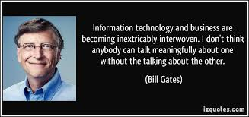

Slide 13
4.3 Simple Mail Transfer Protocol (SMTP)

Slide 14
SMTP
One of the most useful services available on the internet right now is email. SMTP is the protocol used by most internet systems to move mail between users. POP (post office protocol) or IMAP (internet message access protocol) are used to get emails from the recipient's end, while SMTP (send mail) is a push protocol.
What is an SMTP Protocal?
An application layer protocol is SMTP. When sending email, the client establishes a TCP connection with the SMTP server and sends the message across it. The SMTP server is always in an active state. As soon as it checks for a TCP connection from any client, the SMTP process begins a connection through port 25. Instantaneously upon establishing a successful TCP connection, the client process sends the message.

Slide 15
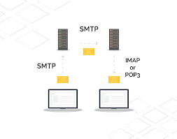
SMTP Components: SMTP Client:
the customer who emails the recipient. Usually, a server application or the user's email client (such as Outlook or Thunderbird) is sending the email.
SMTP Server: the server that gets the email from the client and routes it to either the recipient's mail server or the next server in line.

Slide 16
SMTP Procedure
Sending Emails: Emails are sent to the local SMTP server via port 25, 465 (SSL/TLS), or 587 (STARTTLS) via the email client (SMTP client).
Mail Routing: After processing the email, the SMTP server ascertains the domain of the recipient. The server transfers the email to the recipient's SMTP server if the recipient's domain differs from the sender's domain.
Delivery of Mail: Emails are sent to the receiver's SMTP server, which accepts them and holds them until the recipient uses POP3 or IMAP to retrieve them.

Slide 17
Q&Q Session on Lesson learned

Slide 18
Q&Q Session
Q1: What is DNS and why is it important?
A1: DNS stands for Domain Name System. It is crucial because it translates human-readable domain names (like www.example.com) into IP addresses that computers use to identify each other on the network. Without DNS, users would need to remember numerical IP addresses to access websites.
Q2: What is DHCP and its primary purpose?
A2: DHCP stands for Dynamic Host Configuration Protocol. Its primary purpose is to automate the process of assigning IP addresses, subnet masks, gateways, and other network settings to devices on a network, reducing the need for manual configuration.

Slide 19
Q&Q Session
Q3: What is SMTP and its role in email communication?
A3: SMTP stands for Simple Mail Transfer Protocol. It is used for sending emails from a client to a server or between servers. SMTP handles the transmission of messages to the mail server and between mail servers, ensuring emails reach their intended destination.
Q4: What is FTP and what is it used for?
A4: FTP stands for File Transfer Protocol. It is used for transferring files between a client and a server over a network. FTP enables the uploading and downloading of files, making it useful for website management, file sharing, and backup.

Slide 20
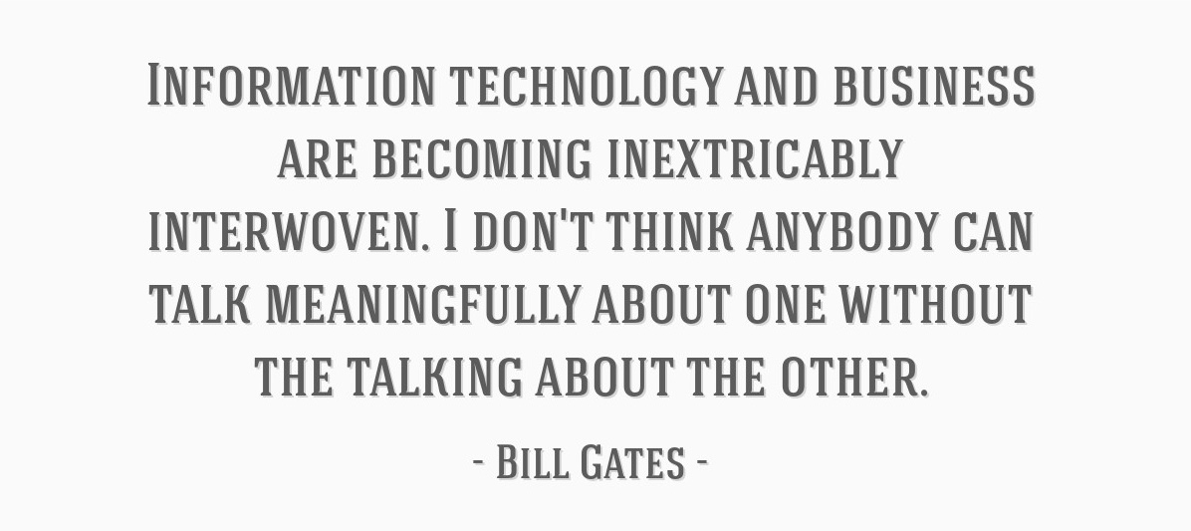

Slide 21
4.4 File Transfer Protocol (FTP)

Slide 22
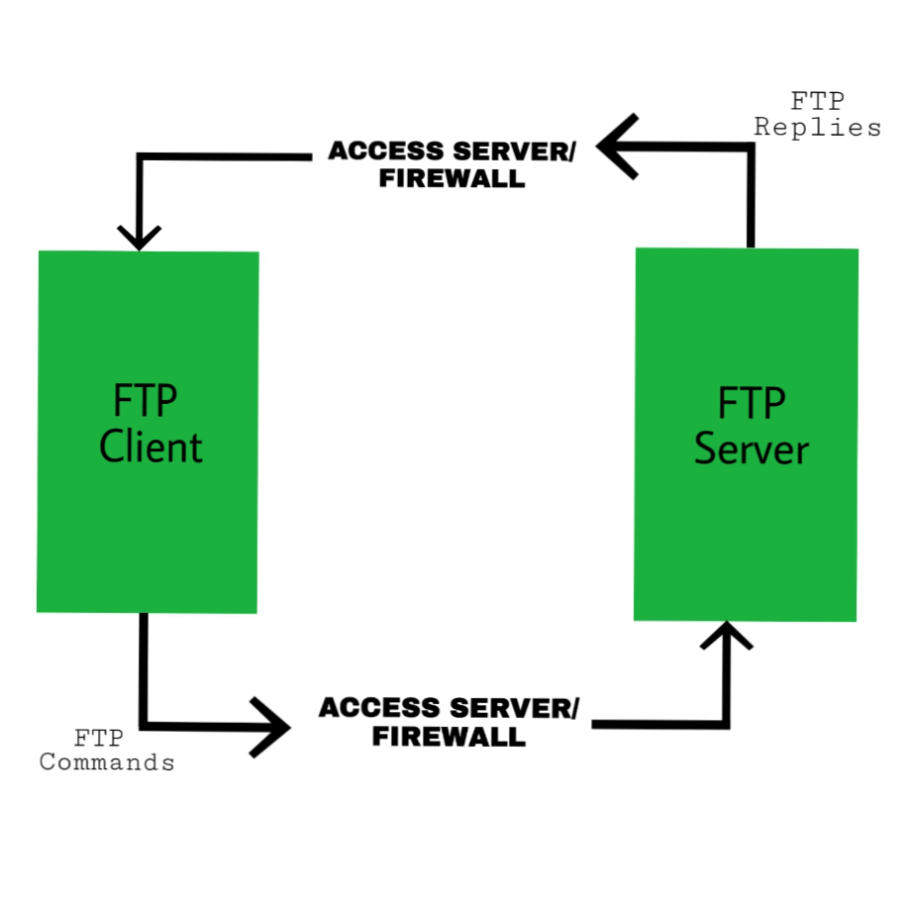
File Transfer Protocol (FTP)
The process of transferring files between devices via a network is known as file transfer protocol, or FTP. When one party permits another to send or receive files via the Internet, the process functions. It was first intended to facilitate communication and information sharing between two physical devices. These days, it's frequently used to store files on the cloud, which is typically a safe area that can be accessed from a distance.

Slide 23
Benefits and Advantages of FTP
Data handling via the Internet became significantly simpler and more user-friendly with FTP. We wouldn't be able to share data, play online games, stream video, conduct video chats, or take advantage of cloud storage without File Transfer Protocol (FTP) and its subsequent versions. These days, FTP runs in the background, providing millions of clients with data transfers from servers all over the world every second of the day. transferring files between devices via a network is known as file transfer protocol, or FTP. When one party permits another to send or receive files via the Internet, the process functions. It was first intended to facilitate communication and information sharing between two physical devices. These days, it's frequently used to store files on the cloud, which is typically a safe area that can be accessed from a distance.

Slide 24
4.5 Secure Shell (SSH)

Slide 25
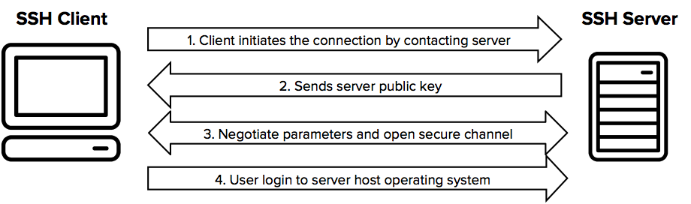
SSH
The SSH (Secure Shell) protocol, software, and associated data can be accessed from this page. A software programme called SSH makes it possible to transfer files and perform secure system management over unreliable networks. It is a staple of almost every big business and data centre. Tatu Ylonen (twitter: @tjssh), the creator of SSH, developed this page. In addition to writing ssh-1.x and ssh-2.x, he continues to work on related projects. On his free version, the OpenSSH implementation is available as open source.

Slide 26
Group Discussion
What is DNS, DHCP, FTP, SSH and SMTP.
What benefits of those protocols.

